Slide 1
Clustering K MEANS

Slide 2
Pattern Recognition

Slide 3
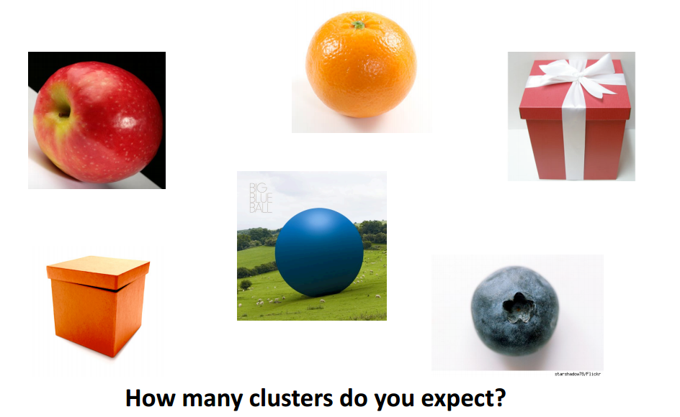
Clustering Analysis

Slide 4
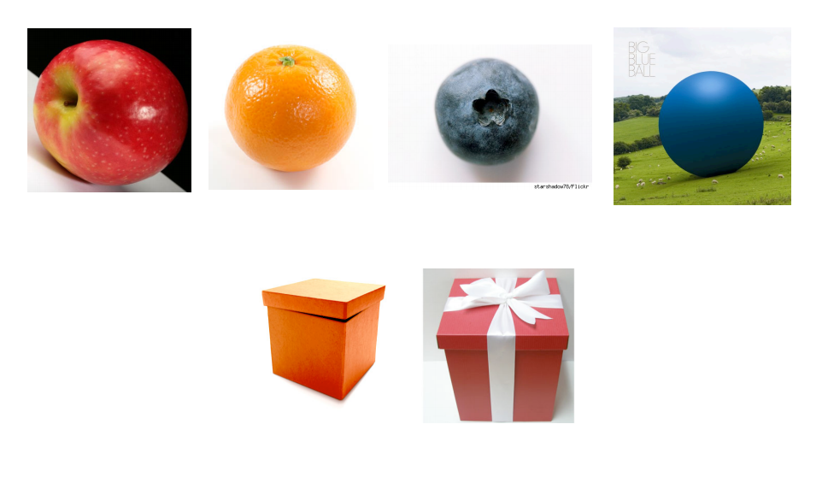

Slide 5
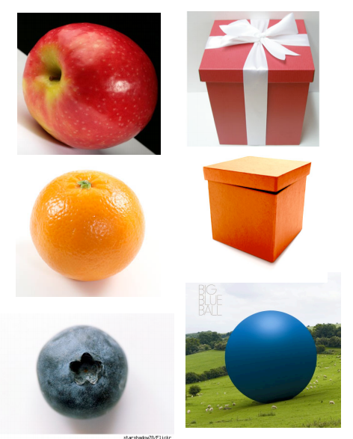

Slide 6


Clustering
Clustering is the categorisation of objects into different groups, or more precisely, the partitioning of a data set into subsets (clusters), so that the data in each subset (ideally) share some common trait - often according to some defined distance measure.

Slide 7
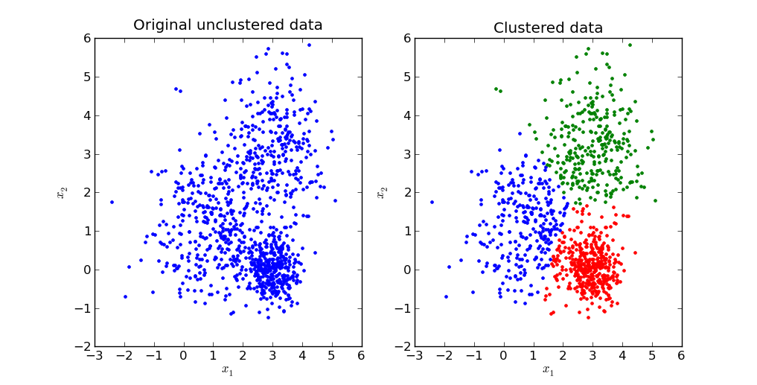

Slide 8
Hierarchical clustering
Agglomerative (Bottom-up)
Compute all pair-wise pattern-pattern similarity coefficients
Place each of n patterns into a class of its own
Merge the two most similar clusters into one
Replace the two clusters into the new cluster
Re-compute inter-cluster similarity scores w.r.t. the new cluster
Repeat the above step until there are k clusters left (k can be 1)

Slide 9
Hierarchical clustering
Agglomerative (Bottom up)

Slide 10
Hierarchical clustering
Agglomerative (Bottom up)
1st iteration
1

Slide 11
Hierarchical clustering
Agglomerative (Bottom up)
2nd iteration
1
2

Slide 12
Hierarchical clustering
Agglomerative (Bottom up)
3rd iteration
3
1
2

Slide 13
Hierarchical clustering
Agglomerative (Bottom up)
4th iteration
3
1
2
4

Slide 14
Hierarchical clustering
Agglomerative (Bottom up)
5th iteration
3
1
2
5
4

Slide 15
Hierarchical clustering
Agglomerative (Bottom up)
Finally k clusters left
3
9
6
1
2
5
8
4
7

Slide 16
Hierarchical clustering
Divisive (Top-down)
Start at the top with all patterns in one cluster
The cluster is split using a flat clustering algorithm
This procedure is applied recursively until each pattern is in its own singleton cluster

Slide 17
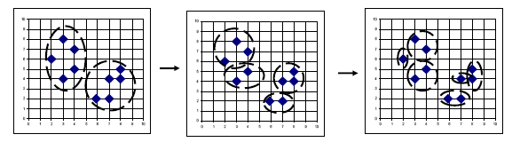
Hierarchical clustering
Divisive (Top-down)

Slide 18
K Means Clustering
Choose k initial centroids (center points).
Each cluster is associated with a centroid.
Each data object is assigned to closet centroid.
The centroid of each cluster is then updated based on the data objects assignment to the cluster.
Repeat the assignment and update steps until convergence.

Slide 19
K-means: Example, k = 3
Step 1: Make random assignments and compute centroids (big dots)
Step 2: Assign points to nearest centroids
Step 3: Re-compute centroids (in this example, solution is now stable)

Slide 20
K Means Clustering

Slide 22
K-means Algorithm
For a given cluster assignment C of the data points, compute the cluster means m_{k}:
For a current set of cluster means, assign each observation as:
Iterate above two steps until convergence

Slide 23
Fuzzy c-means
An extension of k-means
Hierarchical, k-means generates partitions
each data point can only be assigned in one cluster
Fuzzy c-means allows data points to be assigned into more than one cluster
each data point has a degree of membership (or probability) of belonging to each cluster
It is frequently used in pattern recognition.
Notes:
Compare degrees of memberships in k-means and fuzzy c-means

Slide 24
Fuzzy c-means algorithm
Let x_{i} be a vector of values for data point g_{i}.
Initialize membership U⁽⁰⁾ = [ u_{ij} ] for data point g_{i} of cluster cl_{j} by random
At the k-th step, compute the fuzzy centroid C^{(k)} = [ c_{j} ] for j = 1, .., nc, where nc is the number of clusters, using
where m is the fuzzy parameter and n is the number of data points.

Slide 25
Fuzzy c-means algorithm
Update the fuzzy membership U^{(k)} = [ u_{ij} ], using
If ||U^{(k)} – U^{(k-1)}|| < ε, then STOP, else return to step 2.
Determine membership cutoff
For each data point g_{i}, assign g_{i} to cluster cl_{j} if u_{ij} of U^{(k)} > α

Slide 26
Applications of Clustering
Data Mining
Pattern recognition
Image analysis
Bioinformatics
Voice mining
Image processing
Text mining
Web cluster engines
Weather report analysis

Slide 27
Implementation of K-means algorithm (k=2)
Individual | Variable 1 | Variable 2
1 | 1.0 | 1.0
2 | 1.5 | 2.0
3 | 3.0 | 4.0
4 | 5.0 | 7.0
5 | 3.5 | 5.0
6 | 4.5 | 5.0
7 | 3.5 | 4.5

Slide 28
Step 1 Initialization
Individual | Variable 1 | Variable 2
1 | 1.0 | 1.0
2 | 1.5 | 2.0
3 | 3.0 | 4.0
4 | 5.0 | 7.0
5 | 3.5 | 5.0
6 | 4.5 | 5.0
7 | 3.5 | 4.5
Randomly we choose 2 centroids (k=2) for two clusters.
In this case the two centroids are m1=(1.0,1.0) and m2=(5.0,7.0)

Slide 29

Step 2/1 Finding the nearest centroid for every element
Individual | (v1,v2)
1 | (1.0,1.0)
2 | (1.5,2.0)
3 | (3.0,4.0)
4 | (5.0,7.0)
5 | (3.5,5.0)
6 | (4.5,5.0)
7 | (3.5,4.5)
C1 | C2
0 | 7.12
1.12 | 6.10
3.61 | 3.61
7.21 | 0
4.72 | 2.5
5.31 | 2.06
4.30 | 2.92
For every element calculating its distance from center (Euclidian Distance)

Slide 30


Step 2/2 Assigning elements to any of the clusters
Individual | (v1,v2)
1 | (1.0,1.0)
2 | (1.5,2.0)
3 | (3.0,4.0)
4 | (5.0,7.0)
5 | (3.5,5.0)
6 | (4.5,5.0)
7 | (3.5,4.5)
C1 | C2
0 | 7.12
1.12 | 6.10
3.61 | 3.61
7.21 | 0
4.72 | 2.5
5.31 | 2.06
4.30 | 2.92
Thus we obtain 2 clusters containing {1,2,3} and {4,5,6,7}
New centroids are

Slide 31
Step 3 Assigning elements to new clusters according to distance
Individual | (v1,v2)
1 | (1.0,1.0)
2 | (1.5,2.0)
3 | (3.0,4.0)
4 | (5.0,7.0)
5 | (3.5,5.0)
6 | (4.5,5.0)
7 | (3.5,4.5)
C1 | C2
1.57 | 5.38
0.47 | 4.28
2.04 | 1.78
5.64 | 1.84
3.15 | 0.73
3.78 | 0.54
2.74 | 1.08
Now using these centroids m1=(1.83,2.33) & m2=(4.12,5.38) we compute the Euclidean distance of each object, as shown in table.

Slide 32
Step 3 Assigning elements to new clusters according to distance
Individual | (v1,v2)
1 | (1.0,1.0)
2 | (1.5,2.0)
3 | (3.0,4.0)
4 | (5.0,7.0)
5 | (3.5,5.0)
6 | (4.5,5.0)
7 | (3.5,4.5)
C1 | C2
1.57 | 5.38
0.47 | 4.28
2.04 | 1.78
5.64 | 1.84
3.15 | 0.73
3.78 | 0.54
2.74 | 1.08
Therefore, new clusters are:
{1,2} and {3,4,5,6,7}
Next centroids are: m1=(1.25,1.5) and m2 = (3.9,5.1)

Slide 33
Step 4
Individual | (v1,v2)
1 | (1.0,1.0)
2 | (1.5,2.0)
3 | (3.0,4.0)
4 | (5.0,7.0)
5 | (3.5,5.0)
6 | (4.5,5.0)
7 | (3.5,4.5)
C1 | C2
0.56 | 5.02
0.56 | 3.92
3.05 | 1.42
6.66 | 2.20
4.16 | 0.41
4.78 | 0.61
3.75 | 0.72
Now using these centroids m1=(1.25,1.5) & m2 = (3.9,5.1) we compute the Euclidean distance of each object, as shown in table.
Therefore, new clusters are:
{1,2} and {3,4,5,6,7}
Therefore, there is no change in the cluster.
Thus, algorithm comes to a halt here and final result consist of 2 clusters {1,2} and {3,4,5,6,7}.

Slide 35


How to choose K?
Use another clustering method, like EM.
Run algorithm on data with several different values of K.
Use the prior knowledge about the characteristics of the problem.

Slide 36
from sklearn import
cluster, datasets
import matplotlib.pyplot as plt
import seaborn as sns
# nice color
%matplotlib inline
iris = datasets.load_iris()
X = iris.data[:, :2]
# use only 'sepal length and sepal width'
y_iris = iris.target
km2 = cluster.KMeans(n_clusters=2).fit(X)
plt.figure(figsize=(9, 3))
plt.subplot(131)
plt.scatter(X[:, 0], X[:, 1], c=km2.labels_)

Slide 37

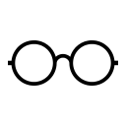
Applications of K-Mean Clustering
It is relatively efficient and fast. It computes result at O(tkn), where n is number of objects or points, k is number of clusters and t is number of iterations.
k-means clustering can be applied to machine learning or data mining
Used on acoustic data in speech understanding to convert waveforms into one of k categories (known as Vector Quantization or Image Segmentation).
Also used for choosing color palettes on old fashioned graphical display devices and Image Quantization.

Slide 38
CONCLUSION
K-means algorithm is useful for undirected knowledge discovery and is relatively simple.
K-means has found wide spread usage in lot of fields, ranging from unsupervised learning of neural network, Pattern recognitions, Classification analysis, Artificial intelligence, image processing, machine vision, and many others.

Slide 39
Happy Learning
Stay Tuned for examples on K Means Clustering

